Slide 1
final draft
File created on: 8/1/2021 9:41:58 PM

Slide 2
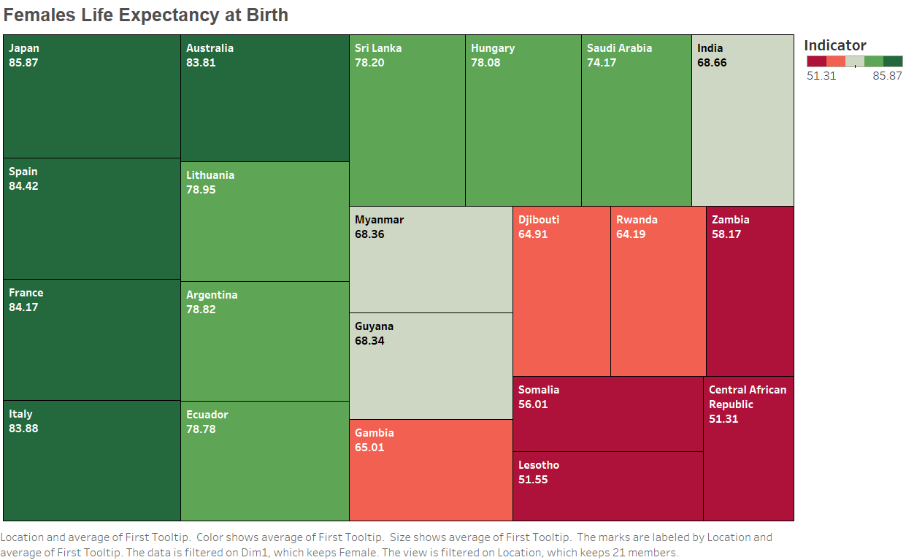

Slide 3
